Slide 2
Species relationship

Slide 3
Species relationship
With time growing, the species’ population either goes to zero, or stable at some constant.
Based on a mathematical model for predicting population dynamics of antagonism species by A.J.Lotka and V.Volterras.

Slide 4
Assume:
When the food is plenty, the birth rate is in direct proportion to its population, and the death rate is related to both the number of predator and prey itself.
Birth rate of predator is depend on the number of prey and predator, and the death rate is depend on the number of predator.

Slide 5
Differential equations based on the assume can be described as follows:
The birth rate of the predator is , the mortality rate is , and the birth rate of the predator is , and the mortality rate is .

Slide 6
Description for some parameter:
K₂ and K₃ indicate predator-prey relationship. K₁ and K₄ indicate reproductive capacity of species. For example, the stronger the predator's reproductive capacity (larger K₁), the greater the number of predators in equilibrium, but the number of predators remains the same. For example, when the mortality rate of predators is higher (such as man-made killing and K₄ becoming larger), it will lead to a decrease in the number of predators.

Slide 7
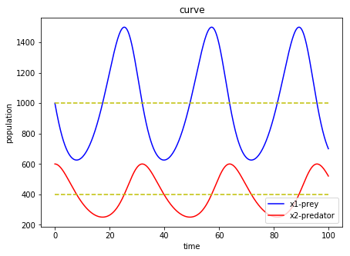
In this first case, the two species depend on each other for the same period, but the predator cycle is later than that of the prey.
K₁=0.2
K₂=0.0005
K₃=0.0002
K₄=0.2
K1/K2=400
K4/K3=1000
Initial :
X1(0)=1000
X2(0)=600

Slide 8
When the number of predators reaches the maximum, predator growth rate reaches the maximum. And predators’ population begin to decrease, the number of predators is just K₁/K₂.
When the number of predators increases to the maximum, the rate of decrease of the prey is also the largest, and the number of the predators is just K₄/K₃.

Slide 9
Since then, the number of predators has declined sharply, and the number of predators has also begun to decrease due to lack of food. During this period, two species are decreasing. When the prey is reduced to a minimum, the number of predators is K₁/K₂ again.
After that, predators began to grow, while predators continued to decrease. As the predator grows to K₄/K₃ again, the predator begins to increase as the food begins enough, and then the predator will increase to the maximum, and the predator will increase to K₁/K₂. At this point, a number of changes in the cycle is completed.

Slide 10
Model 2
Previous differential equation does not consider the reduction in quantity due to competition within its own population. Considering this point, the differential equation at this time is changed to:

Slide 11
Consider stability, when the increase or decrease rate is zero (which the same as the value for differential equation is zero), system stable.

Slide 12
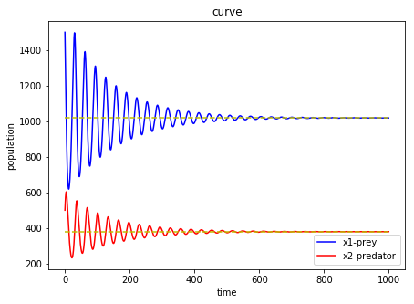
Based on the previous one, also consider the competition within population. The addition of this factor takes the limitation of environmental resources into account.
K₁=0.2
K₃=0.0005
K₄=0.0002
K₆=0.2
K₂=0.00001
K₅=0.00001
Initial:
X₁(0)=1500
X₂(0)=500

Slide 13
The population returns to a stable value after a certain period of oscillation.

Slide 14
Model 3
Consider two models of predators competing for the same food species. The factors considered remain unchanged, but the prey is affected by two predators. The prey is X , and the predator is Y₁ and Y₂

Slide 16
Infectious disease model

Slide 17
model1
Assume:
1. Each individual has the same probability to get disease. Once the individual get disease, he/she will stay in the diseased status
2. The propagation speed depends on the number of infection individual and the number of easy-infection individual
3. The total population is constant

Slide 18
Infected : Y(t)
Uninfected: X(t)
X(t) + Y(t) = N (constant)
Y’[t] = KX[t]Y[t] X[t] +Y[t] = N
Y’[t] = K(N-Y[t])Y[T]

Slide 19
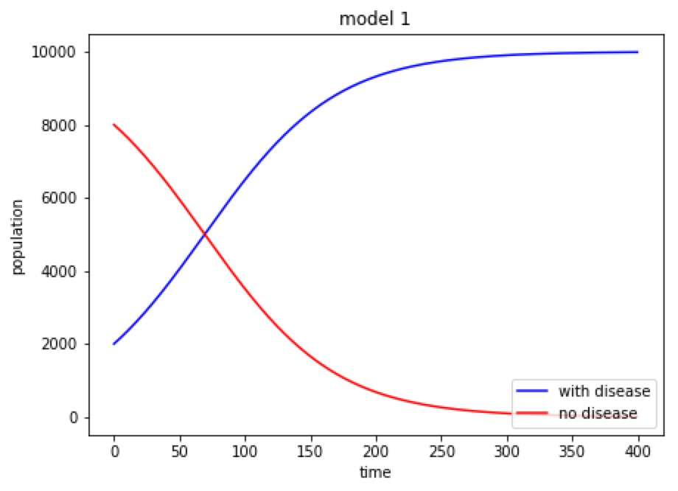
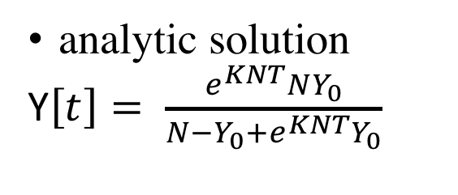
analytic solution
Y$\left[t\right]= \frac{e^{KNT}NY_{0}}{N−Y_{0}+e^{KNT}Y_{0}}$
N=10000
Y0=2000
K=0.000002

Slide 20
Model 2
Contagion or disease caused by parasite could retain the speed of natural increase of population
Assume:
Population: N(t) = X(t) + Y(t) + Z(t)
Uninfected: X(t)
Infected: Y(t)
Recovery with immunity: Z(t)

Slide 21
Parameters
K₁: #healthy individual coming from external environment in unit time
K₂: normal death rate
K₃: healthy individual infection rate( not include individuals with immunity)
K₄: rate of individuals lost their immunity
K₅: fatality rate
K₆: recovery rate

Slide 22
Differential Equation
X’[t] = K₁ – K₂ X[t] – K₃X[t]Y[t] + K₄ Z[t]
Y’[t] = K₃X[t]Y[t] –(K₂+ K₅+ K₆)Y[t]
Z’[t] = K₆Y[t] –(K₂+ K₄)Z[t]
N’[t] = K₁ – K₂N[t] –K₅Y[t]
Didn’t consider natural growth rate. The increase of population is caused by individual coming from external environment
Individual death rate is constant. Didn’t consider the restriction of environment recourse.

Slide 23
Differential Equation
Make the left part of differential equation to be 0 to get non-linear equation set:
0= K₁ – K₂ X[t] – K₃X[t]Y[t] + K₄ Z[t]
0 = K₃X[t]Y[t] –(K₂+ K₅+ K₆)Y[t]
0 = K₆Y[t] –(K₂+ K₄)Z[t]
And get the solution of equation set

Slide 24
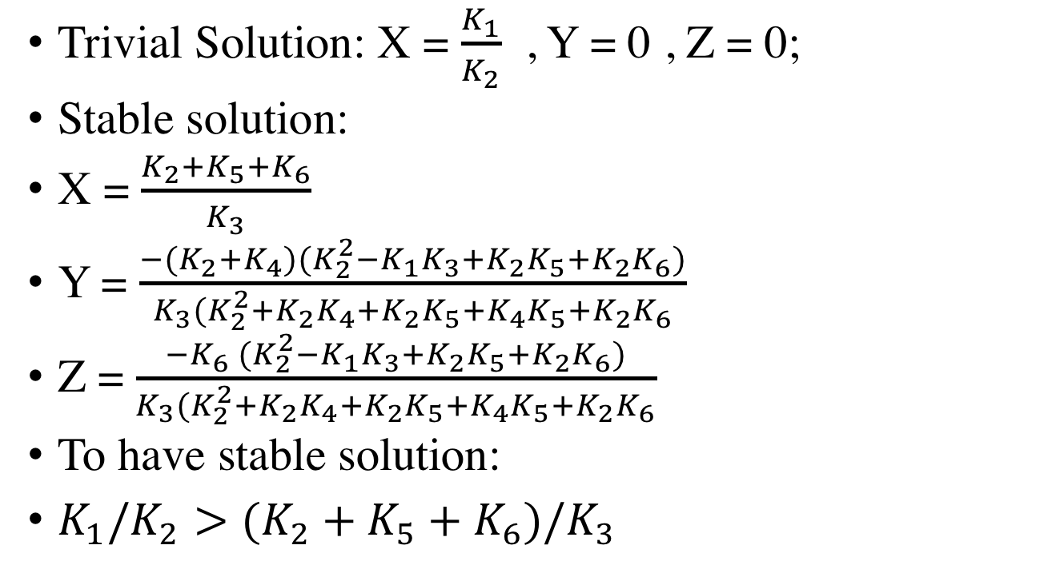
Differential Equation
Trivial Solution: X = $\frac{K_{1}}{K_{2}}$ , Y = 0 , Z = 0;
Stable solution:
X = $\frac{K_{2}+K_{5}+K_{6}}{K_{3}}$
Y = $\frac{{−(K}_{2}+K_{4})(K_{2}^{2}−K_{1}K_{3}+K_{2}K_{5}+K_{2}K_{6})}{K_{3}(K_{2}^{2}+K_{2}K_{4}+K_{2}K_{5}+K_{4}K_{5}+K_{2}K_{6}}$
Z = $\frac{{−K}_{6} (K_{2}^{2}−K_{1}K_{3}+K_{2}K_{5}+K_{2}K_{6})}{K_{3}(K_{2}^{2}+K_{2}K_{4}+K_{2}K_{5}+K_{4}K_{5}+K_{2}K_{6}}$
To have stable solution:
$K_{1}/K_{2}>(K_{2}+K_{5}+K_{6})/K_{3}$

Slide 25
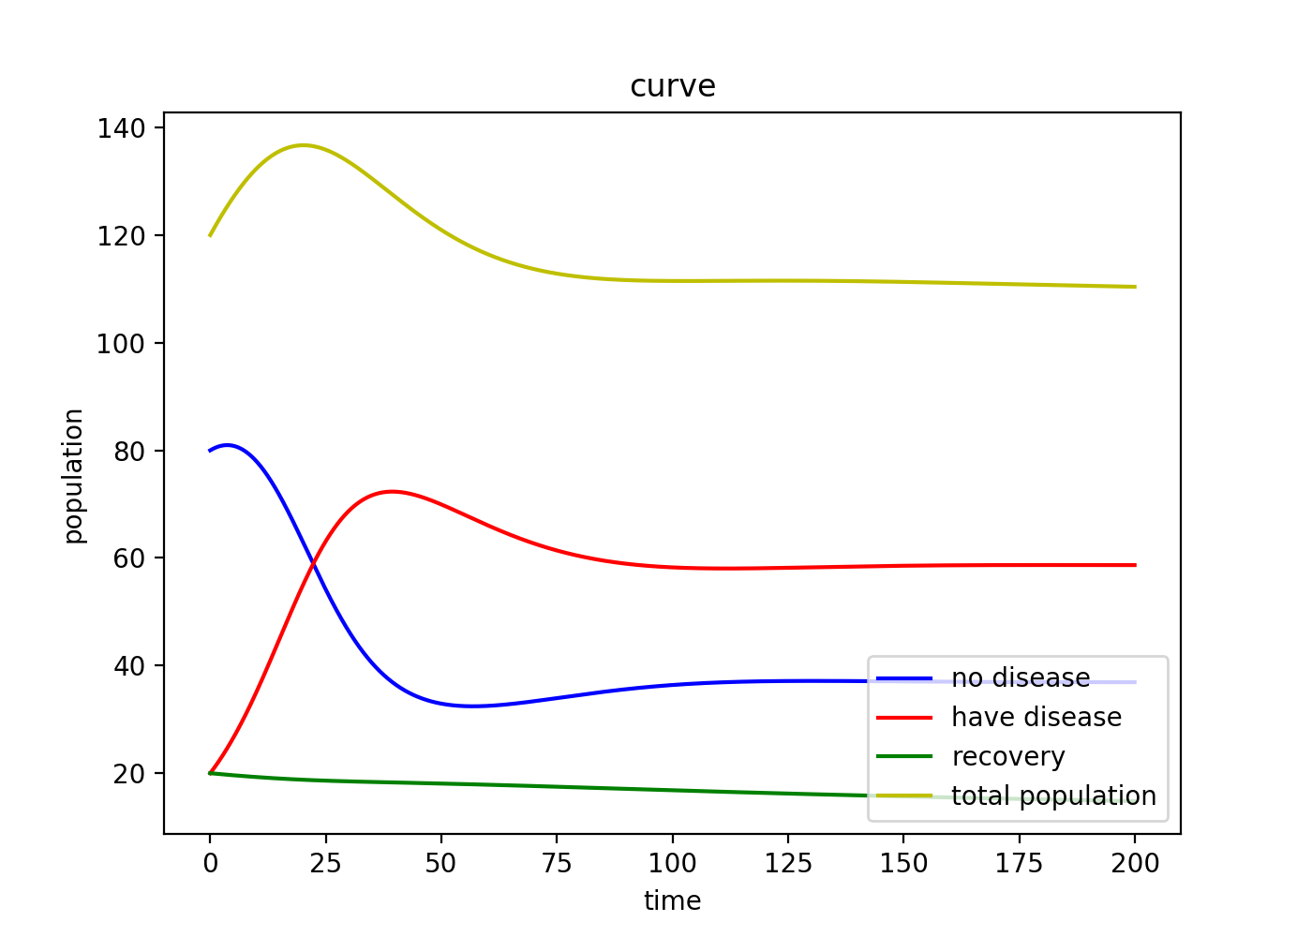
K1=3
K2=0.005
K3=0.0013
K4=0
K5=0.042
K6=0.001
X(0)=80
Y(0)=20
Z(0)=20
N(0) =120

Slide 26
Model 3
Add birth rate to model1
Change K₁:birth rate (K₁> K₂ to let population increase)
K₁ is a constant and has no relation to whether individual has disease or not.

Slide 27
Differential Equation
X’[t] = K₁ N[t] – K₂ X[t] – K₃X[t]Y[t] + K₄ Z[t]
Y’[t] = K₃X[t]Y[t] –(K₂+ K₅+ K₆)Y[t]
Z’[t] = K₆Y[t] –(K₂+ K₄)Z[t]
N’[t] = (K₁ – K₂)N[t] –K₅Y[t]

Slide 28
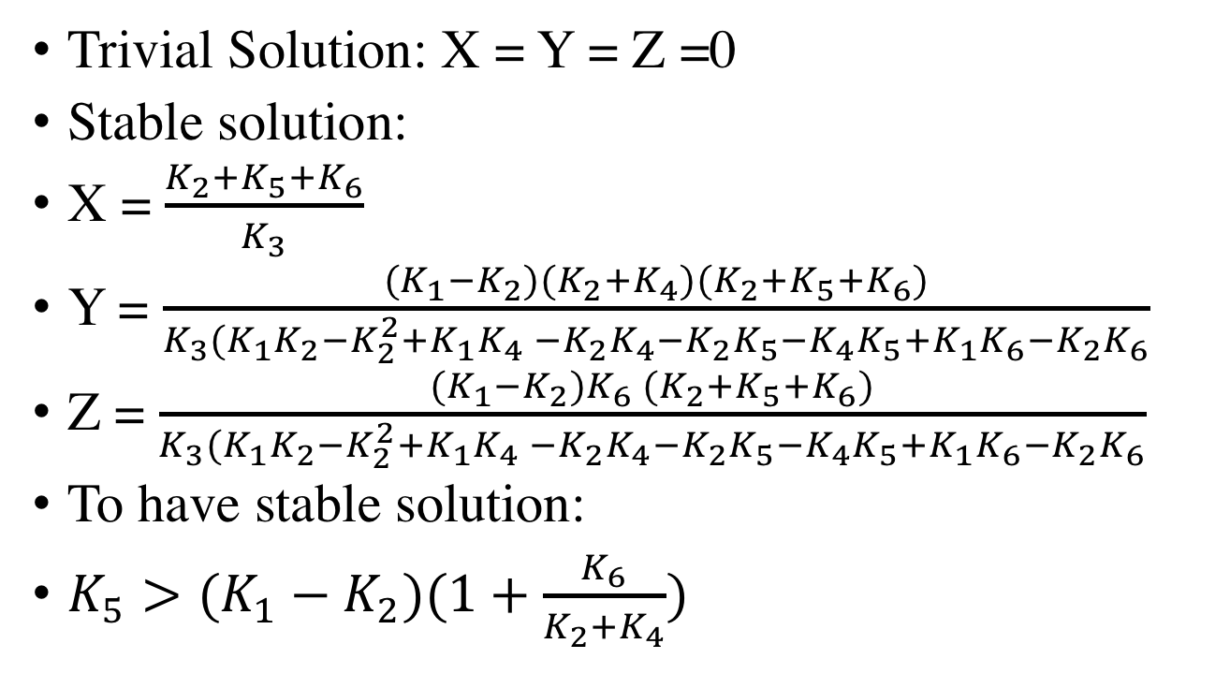
Differential Equation
Trivial Solution: X = Y = Z =0
Stable solution:
X = $\frac{K_{2}+K_{5}+K_{6}}{K_{3}}$
Y = $\frac{{(K}_{1}−K_{2})(K_{2}+K_{4})(K_{2}+K_{5}+K_{6})}{K_{3}(K_{1}K_{2}{−K}_{2}^{2}+K_{1}K_{4} −K_{2}K_{4}−K_{2}K_{5}−K_{4}K_{5}+K_{1}K_{6}−K_{2}K_{6}}$
Z = $\frac{{(K}_{1}−K_{2})K_{6} (K_{2}+K_{5}+K_{6})}{K_{3}(K_{1}K_{2}{−K}_{2}^{2}+K_{1}K_{4} −K_{2}K_{4}−K_{2}K_{5}−K_{4}K_{5}+K_{1}K_{6}−K_{2}K_{6}}$
To have stable solution:
$K_{5}>(K_{1}−K_{2})(1+\frac{K_{6}}{K_{2}+K_{4}})$

Slide 29
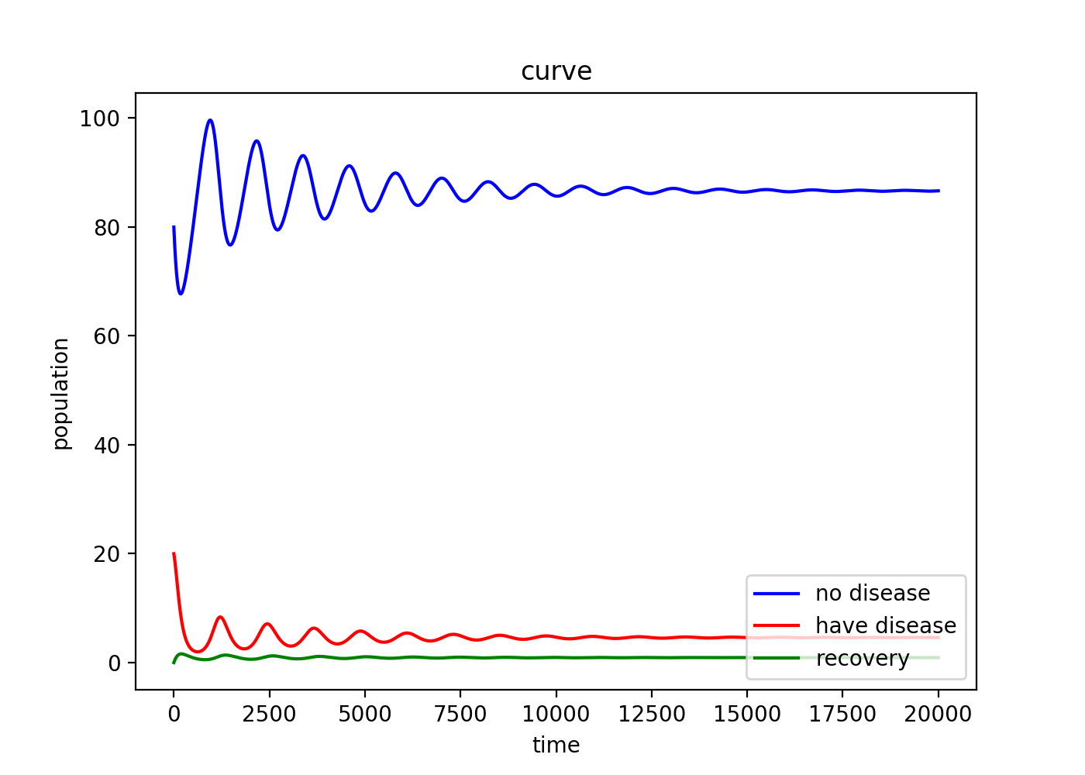
K1=0.006 K2=0.005 K3=0.0003
K4=0
K5=0.02 K6=0.001
X(0)=80
Y(0)=20
Z(0)=0
N(0) = 120
￼

